Slide 1
GANomaly: Semi-Supervised Anomaly Detection via Adversarial Training
Samet Akcay, Amir Atapour-Abarghouei , and Toby P. Breckon

Slide 2
- Anomaly detection is a classical problem in computer vision, namely the determination of the normal from the abnormal when datasets are highly biased towards one class (normal) due to the insufficient sample size of the other class (abnormal).

Slide 3
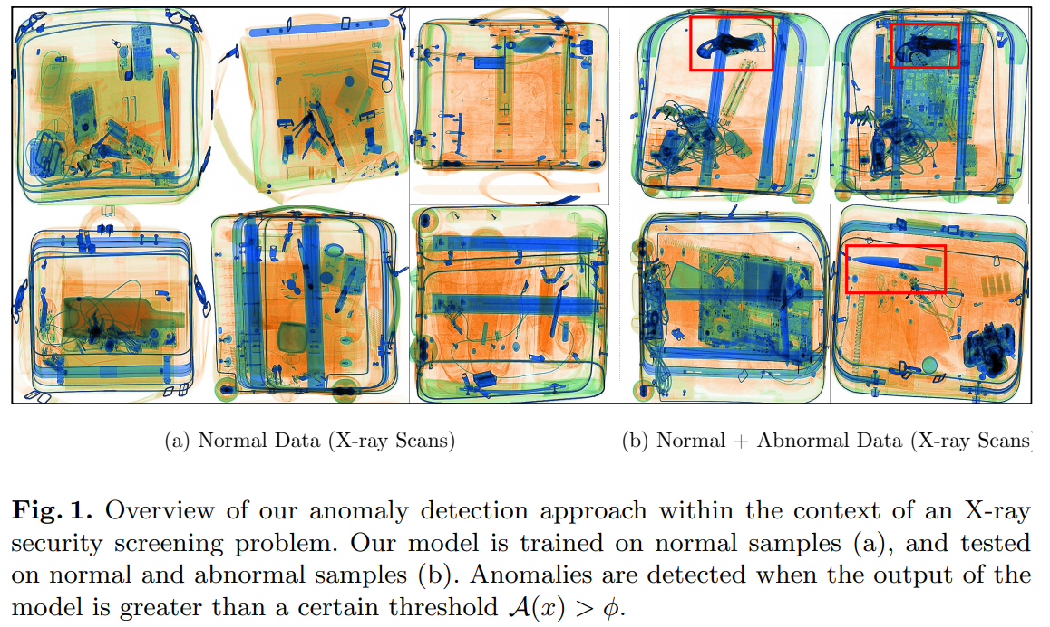

Slide 4
semi-supervised anomaly detection : a novel adversarial auto encoder with in an encoder-decoder-encoder pipeline, capturing the training data distribution within both image and latent vector space, yielding superior results to contemporary GAN-based and traditional autoencoder-based approaches
efficacy : an efficient and novel approach to anomaly detection that yields both statistically and computationally better performance.
reproducibility : simple and effective algorithm such that the results could be reproduced via the code made publicly available

Slide 5
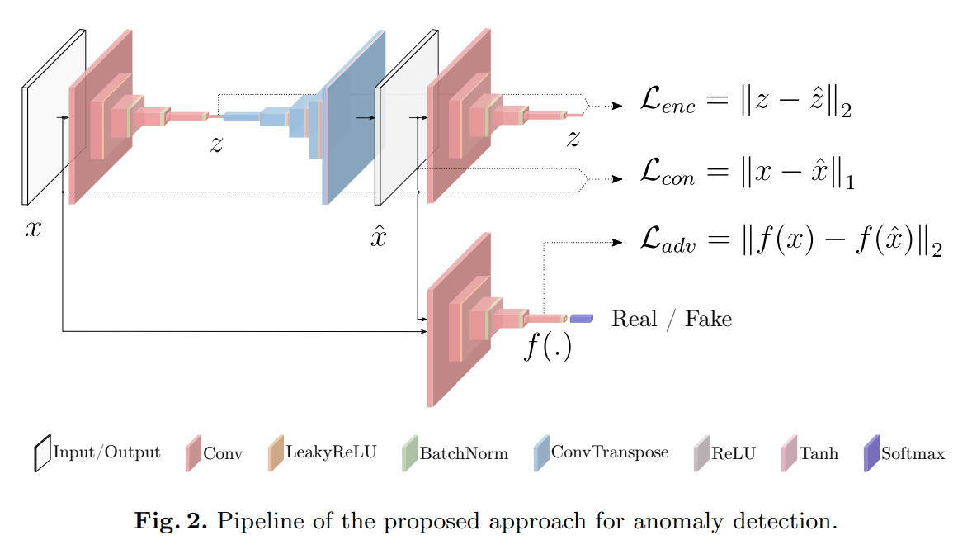
Our Approach: GANomaly

Slide 6
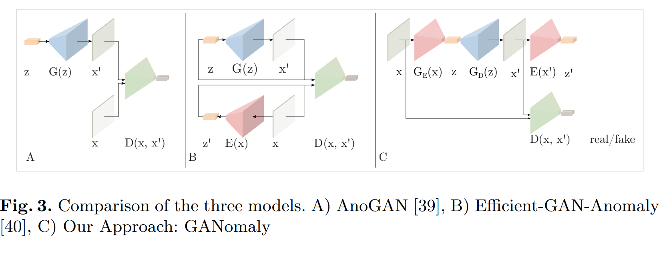
Our Approach: GANomaly

Slide 7

Our Approach: GANomaly
Adversarial Loss.
Unlike the vanilla GAN where G is updated based on the output of D (real/fake), here we update G based on the internal representation of D. Formally, let f be a function that outputs an intermediate layer of the discriminator D

Slide 8

Our Approach: GANomaly
Contextual Loss.

Slide 9

Our Approach: GANomaly
Encoder Loss.

Slide 10
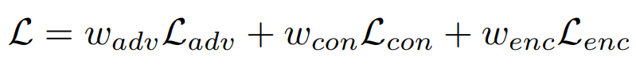
Our Approach: GANomaly
where w(adv), w(adv) and w(adv) are the weighting parameters adjusting the impact of individual losses to the overall objective function.

Slide 11
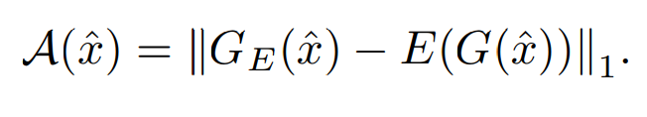
our anomaly score A(ˆx)

Slide 12
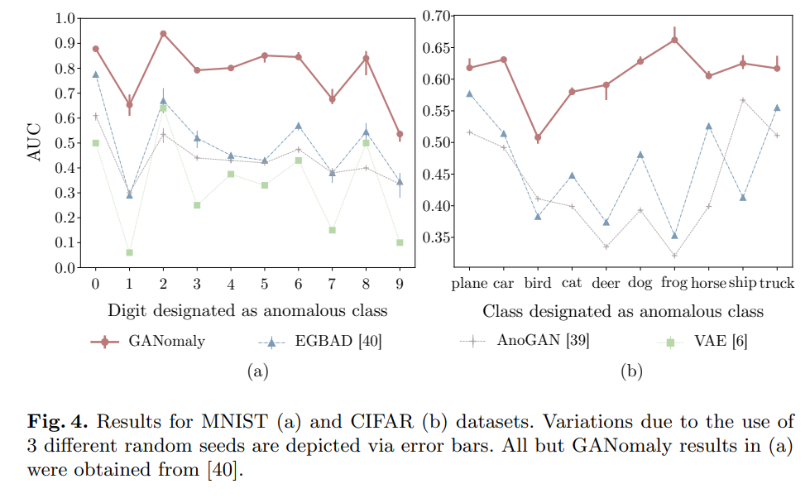

Slide 13
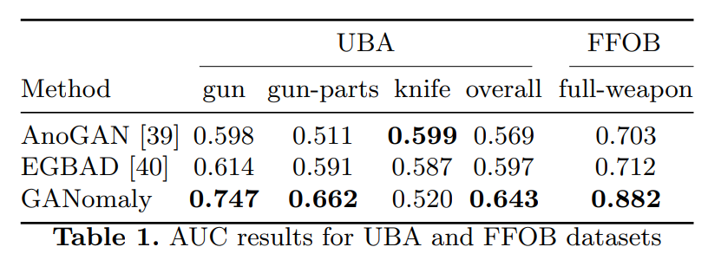

Slide 14
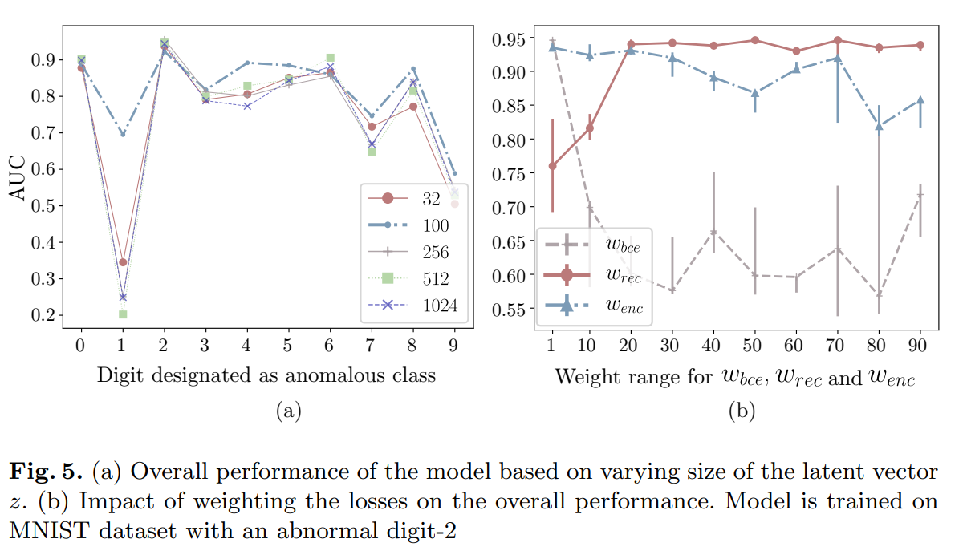

Slide 15
감사합니다.

